Slide 1
The JMSC screens and nominates all judges for the following:
Supreme Court
Court of Appeals
Circuit Court
Family Court
Administrative Law Court
Master-In-Equity

Slide 2
Statutory & Constitutional Requirements for JMSC Candidates
All of the candidates, no matter what judicial
office sought, must be:
(1) a citizen of the United States and of S.C.
(2) at least 32 years of age;
(3) a licensed attorney at law for at least 8 years;
(4) a resident of South Carolina for 5 years
preceding his/her election.

Slide 3
What evaluative criteria must each judicial candidate meet?
1) constitutional qualifications;
2) ethical fitness;
3) professional and academic ability;
4) character;
5) reputation;
6) physical health;
7) mental stability;
8) experience; and
9) judicial temperament.

Slide 4
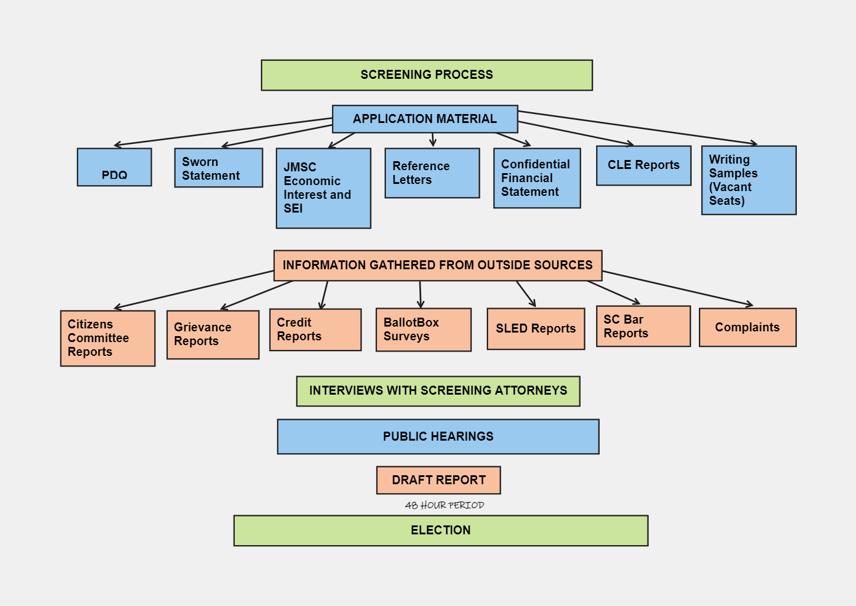

Slide 5
Application Materials
The candidate submits a minimum of eight application documents to include a personal data questionnaire (PDQ), Sworn Statement, JMSC Economic Interest Form, State Ethics Commission Form (SEI), Confidential Financial Statement, five letters of recommendation, CLE reports for the past five years, and writing samples if seeking an open seat.
The application documents must be turned in no later than a published deadline to be considered a judicial candidate.

Slide 6
Materials Gathered from Outside Sources: Citizens Committee Reports Grievance Reports Credit Reports BallotBox Survey Results SLED Reports SC Bar Reports Complaints

Slide 7
Citizens Committee Reports
The candidates are “researched” and interviewed by one of the five Citizens Committees in the state. The committees are comprised of up to 10 members from the Pee Dee, Lowcountry, Upstate, Piedmont, and Midlands regions.
Members appointed by Chair and VC of JMSC
The committees issue reports for each candidate based on the 9 evaluative criteria.
The screening attorneys and JMSC members receive reports from each committee, and they are made a part of the public record at the public hearing.

Slide 8
SC Bar Reports
The candidates are “researched” and interviewed by the SC Bar’s JQC.
The SC Bar has specific criteria that they attempt to meet as they research each candidate. For example, at least 30 phone calls are made on each candidate during the investigation.
The SC Bar asks questions about substantive law and background information during the interview.
The SC Bar issues reports for each candidate based on the 9 evaluative criteria.
The screening attorneys and JMSC members receive the SC Bar reports and they are made public record at the public hearing.

Slide 9
Grievance Reports
JMSC receives letters from the Commission on Lawyer Conduct and the Commission on Judicial Conduct stating whether there is a record of discipline from the Supreme Court in the area of misconduct.

Slide 10
BallotBox Surveys
All active members of the South Carolina Bar and Clerks of Court are sent a survey to report on the evaluative criteria of the candidates.
Emails used are those on file with the Supreme Court.
The company that we contract with to handle these surveys is BallotBox, out of Texas.
The surveys are anonymous, and responses are confidential.
Candidates are informed of general concerns and themes raised as well as positive themes during interview with screening attorney. These are addressed at public hearing.

Slide 11
SLED & Credit Reports
SLED reports
SLED conducts a thorough investigation and background check on each candidate and issues a report to the commission.
Credit Reports
The Senate Clerk’s office runs a credit report for each candidate. This report is added to the candidate’s financial file. Staff compares it to the submitted confidential financial statement.

Slide 12
Complaints
If a person wishes to file a complaint and testify concerning a judicial candidate at the public hearings, he/she must submit an affidavit of complaint form with supporting documentation in person or by mail by a strict deadline.
For the complaint to be accepted by the Commission, it must state allegations relating to the candidate’s character, competency, or ethics.
Note that letters or testimony in support of candidates are prohibited

Slide 13
Screening Attorney Interviews
Using the application documents, information received from outside sources, and staff’s investigation, the screening attorneys conduct interviews with their assigned candidates.
The screening attorneys provide pertinent information on each candidate to the commission in preparation for the public hearings.
The screening attorneys prepare the judicial candidates for the public hearings.

Slide 14
Confidentiality of Records
Section 2-19-50 provides that all records and any information JMSC obtains to make findings must be kept strictly confidential and are not subject to FOIA.
Once materials are presented under oath at public hearing, they are not confidential.
After the report is issued, any confidential materials must be destroyed

Slide 15
Public Hearing
The candidates appear before the 10 members of the JMSC at the public hearing.
Any complaints are heard.
After some housekeeping questions by the screening attorney, the members of the JMSC can ask the candidates about any positive or negative themes uncovered during the screening process.
If the members want to ask a question on a private matter such as the financial records of the candidate, the JMSC can go into executive session where the public is escorted out of the room.

Slide 16
Public Hearing
Candidates may withdraw their name from consideration at any time. At that time, records are destroyed per statute.
The JMSC votes on whether candidate is qualified and of those candidates, may nominate up to three candidates best qualified for each seat
Exceptions-
Retired judges- vote on whether qualified to serve. If qualified, the Chief Justice may appoint judge at his discretion.
Masters In Equity- all qualified candidates sent to Legislative Delegation, and they vote and send the name of one candidate to Governor for consideration of appointment.

Slide 17
Public Hearing
Note- if the Incumbent Judge is found not qualified, or dies, withdraws, or becomes otherwise disqualified between the time he files his application and the date of the election, then the election for that position will not be held.
The position is treated as a new vacancy and the entire process re-started.

Slide 18
Draft Report
The draft Report is issued and published by JMSC (in 2024, on Thursday, Jan. 11).
At least 48 hours later, the draft report becomes FINAL (in 2024, 12:00 noon, Tuesday, January 16) and at only at that point, may requests and pledges for votes be made. See Section 2-19-70(C)
Per statute, at least 2 weeks must pass before GA conducts election.

Slide 19
Election
Concurrent resolution must be passed by both bodies setting date of election.
Election has typically been held the first or second week of February.

